Slide 1



Slide 2

"P300 Spellers: Elevating Performance through Cutting-Edge Feature Extraction Analysis"
April 28, 2024
Diptyajit Das, Bhawna Kapoor, Tanaya Das, Zahra Maleki, Puneet Tomar
Email: tomarp@pm.me

Slide 3
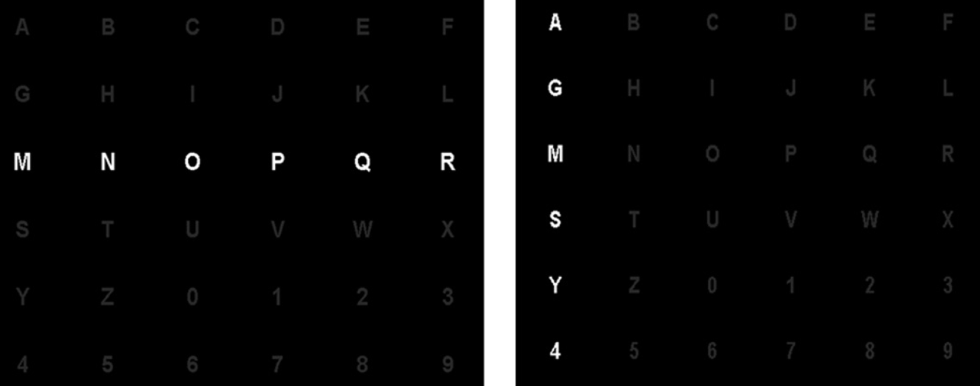
Problem Statement
Can we design a novel classifier that can improve P300 Speller performance based on features ?
SOTA
the row/column speller (RC) that flashes an entire column or row of characters
Row/Column speller (RC)
Subjects paid attention to speller flashes with multiple character at once.
Time-variant Linear Discriminant Analysis (TVLDA)
Subjects: 5, 8 channels EEG data, 250 Hz sampling rate.
TVLDA outperformed LDA classifier with a high accuracy (~90%).
[2] Ref. https://doi.org/10.1016/j.neulet.2009.06.045

Slide 4
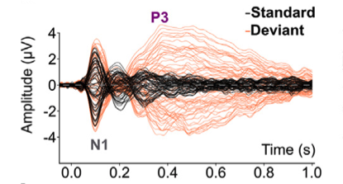
P300 speller
What is P3/P300?
Prominent positive event-related potential (ERP) in EEG.
Reflects brain activity approx. 300 ms after the target stimuli.
Popular in BCI paradigm: easy to detect, high accuracy and speed.
[1] Ref. https://doi.org/10.1016/j.clinph.2023.11.014.

Slide 5
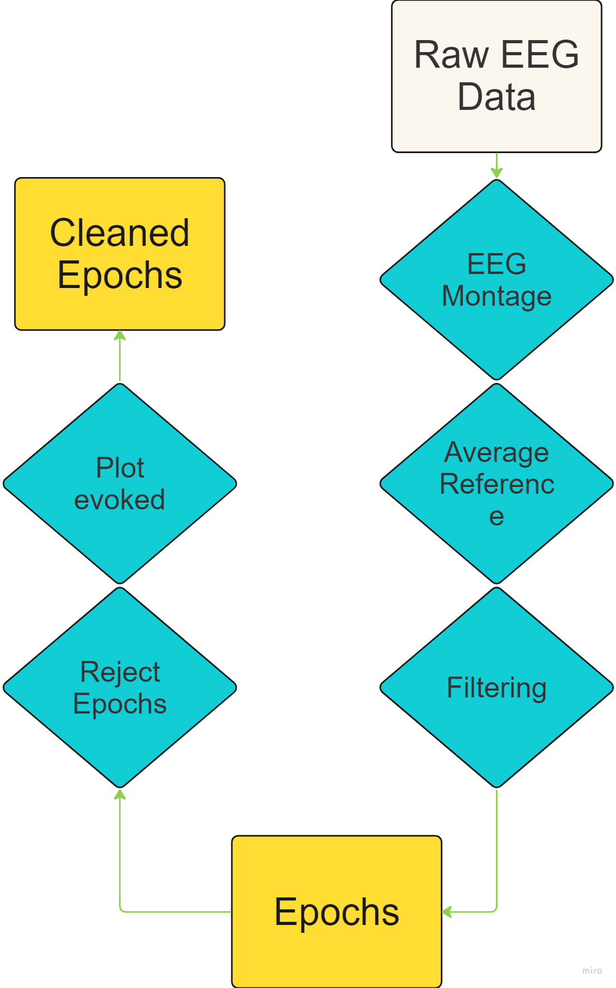
Methodology (Pre-Processing)
Steps performed:
MNE styled Raw object creation (raw data)
EEG montage creation
Reference electrodes to common average
Bandpass filtering (1., 30. hz)
Epochs creation (-0.1 to 0.8s)
Plot evoked for quality control

Slide 6
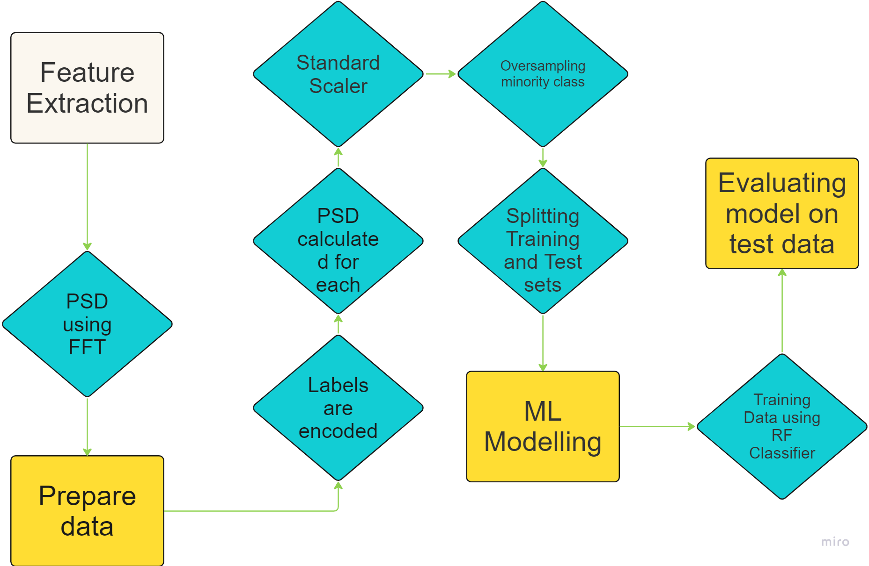
Methodology - (ML workflows)
Steps performed:
PSD extraction using FFT
labels encoded numerically
psd feature calculated for each epoch
features are normalised -> StandardScaler
addressing class imbalance
splitting data into training and testing
RF - RandomForest
Notes:
BDPTZ

Slide 7
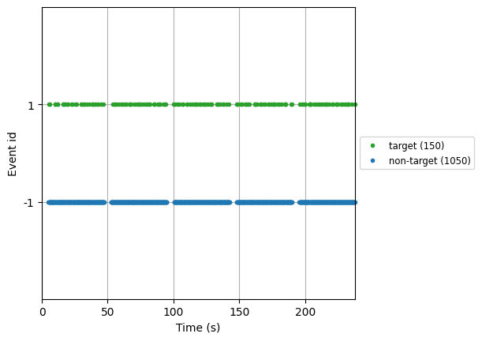
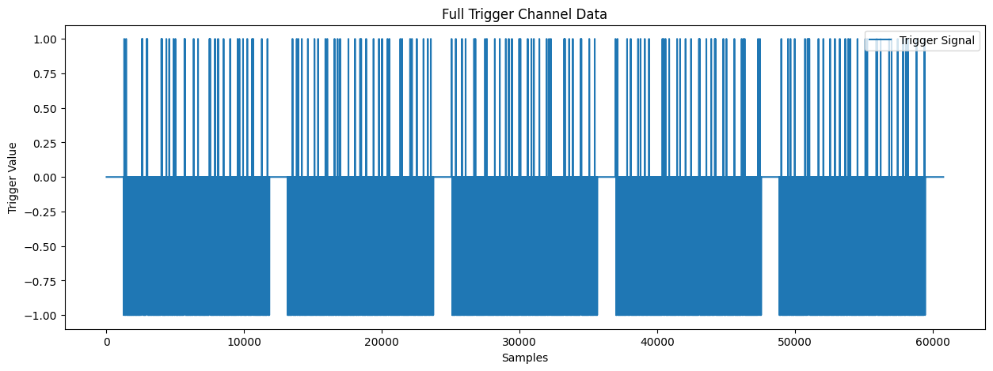
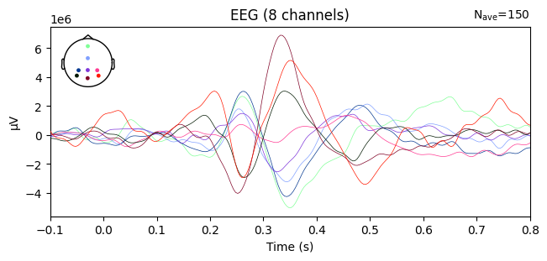
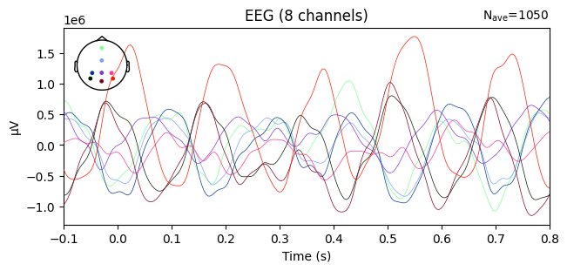
Quality control:
Plot 1: Trigger information
Plot 2: cleaned events , (target vs non-target)
Plot 3: evoked signal from one subject (target)
Plot 4: evoked signal from one subject (non-target)

Slide 8
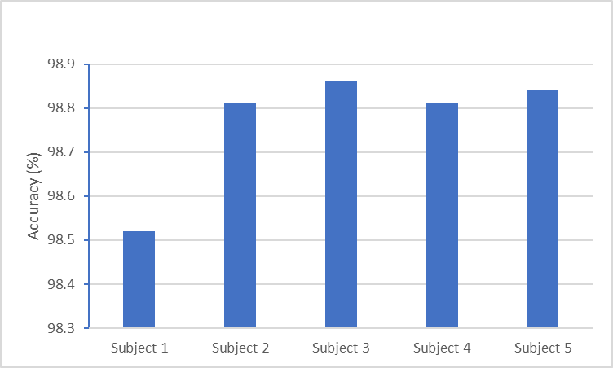
RESULTS (1)
All subjects achieved more than 98% accuracy
Plot 5: Accuracy of RF classifier for each subject

Slide 9
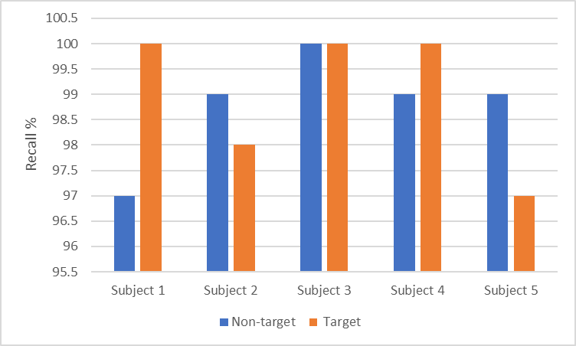
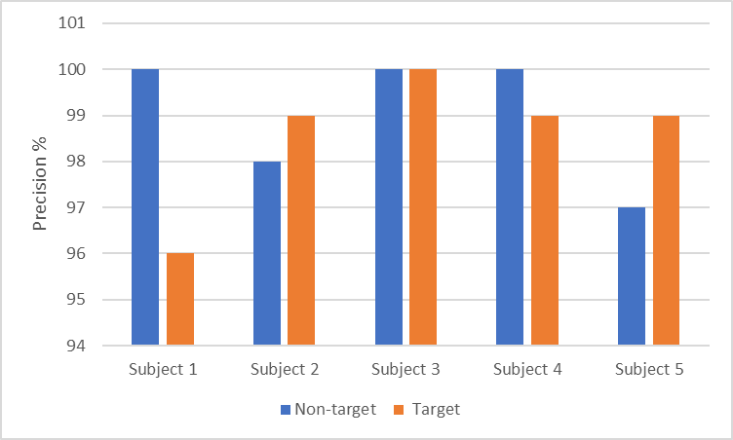
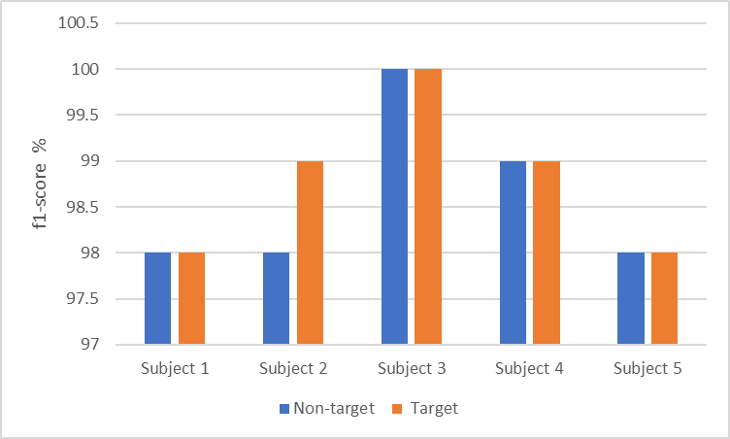
RESULTS (2)
Plot 6 : Metrics obtained for RF classifier

Slide 10
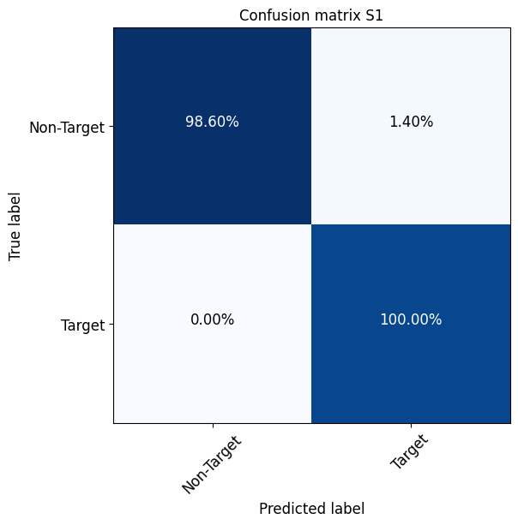
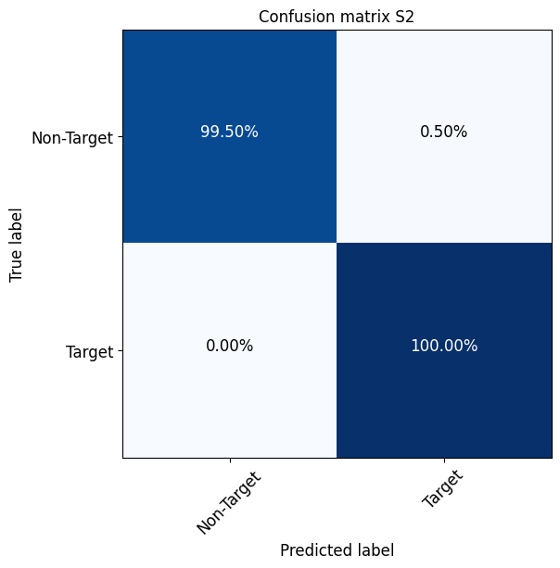



RESULTS (3)
Plot 7: Confusion matrix obtained for each subject

Slide 11
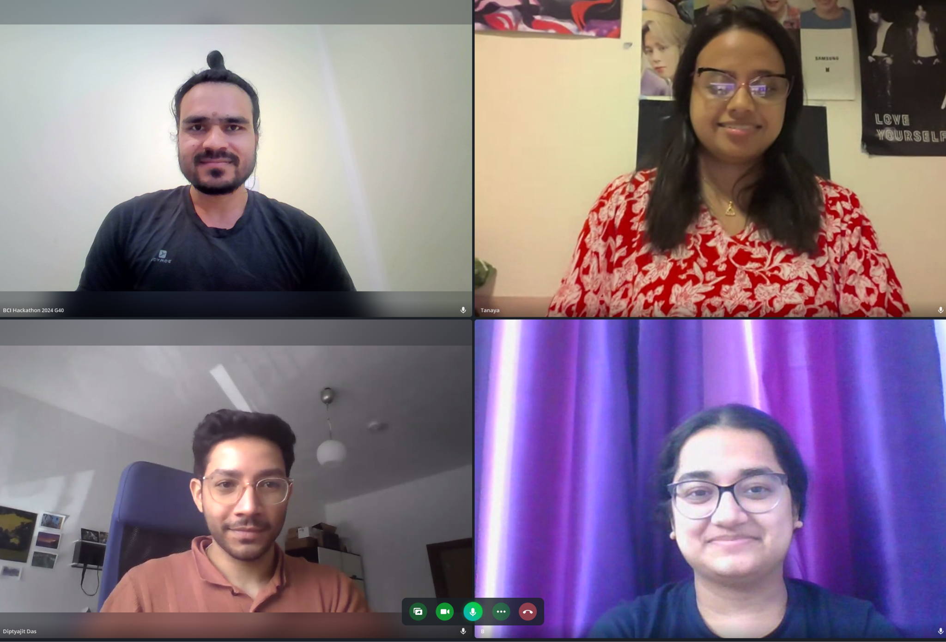
We are Neuroide !!

Slide 12
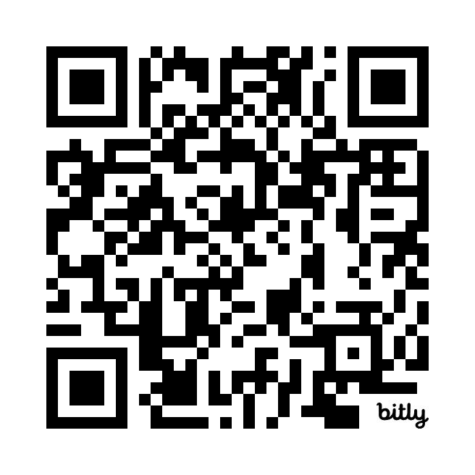
"Unleashing the Power of P300 Spellers: Elevating Performance through Cutting-Edge Feature Extraction Analysis"
Diptyajit Das, Bhawna Kapoor, Tanaya Das, Zahra Maleki, Puneet Tomar
Email: tomarp@pm.me
Code is available at github

